Slide 1
Linear Relationships in Practical Situations

Slide 2
Electrician A charges $60 call out fee and then $50 per hour for the time he spends on the job. Write an equation for this linear relationships and sketch a graph to find the cost of a job which he spends 3 hours on.
Let
c = the cost of the job ($)
t = time he spends on the job (hours)
c = mt + constant [y = mx + c]
The call out fee is $60 – this is the constant, the fee that is charged independent on the hours he spends on the job.
The gradient is the rate - $50/hour
c = 50t + 60

Slide 3
c = 50t + 60
y – intercept (constant)
Slope (rate - $50/hour)

Slide 4
Electrician B charges $70 per hour for the time he spends on the job but no call out fee. Write an equation for this linear relationships and sketch a graph of this relationships on the same graph. If you want an electrician for a job which lasts 4 hours, who would you use. Justify your answer.
Let
c1 = the cost of the job ($)
t = time he spends on the job (hours)
c1 = mt + constant [y = mx + c]
The call out fee is $0
The gradient is the rate - $70/hour
c = 70t

Slide 5
c = 70t
c = 50t + 60

Slide 6
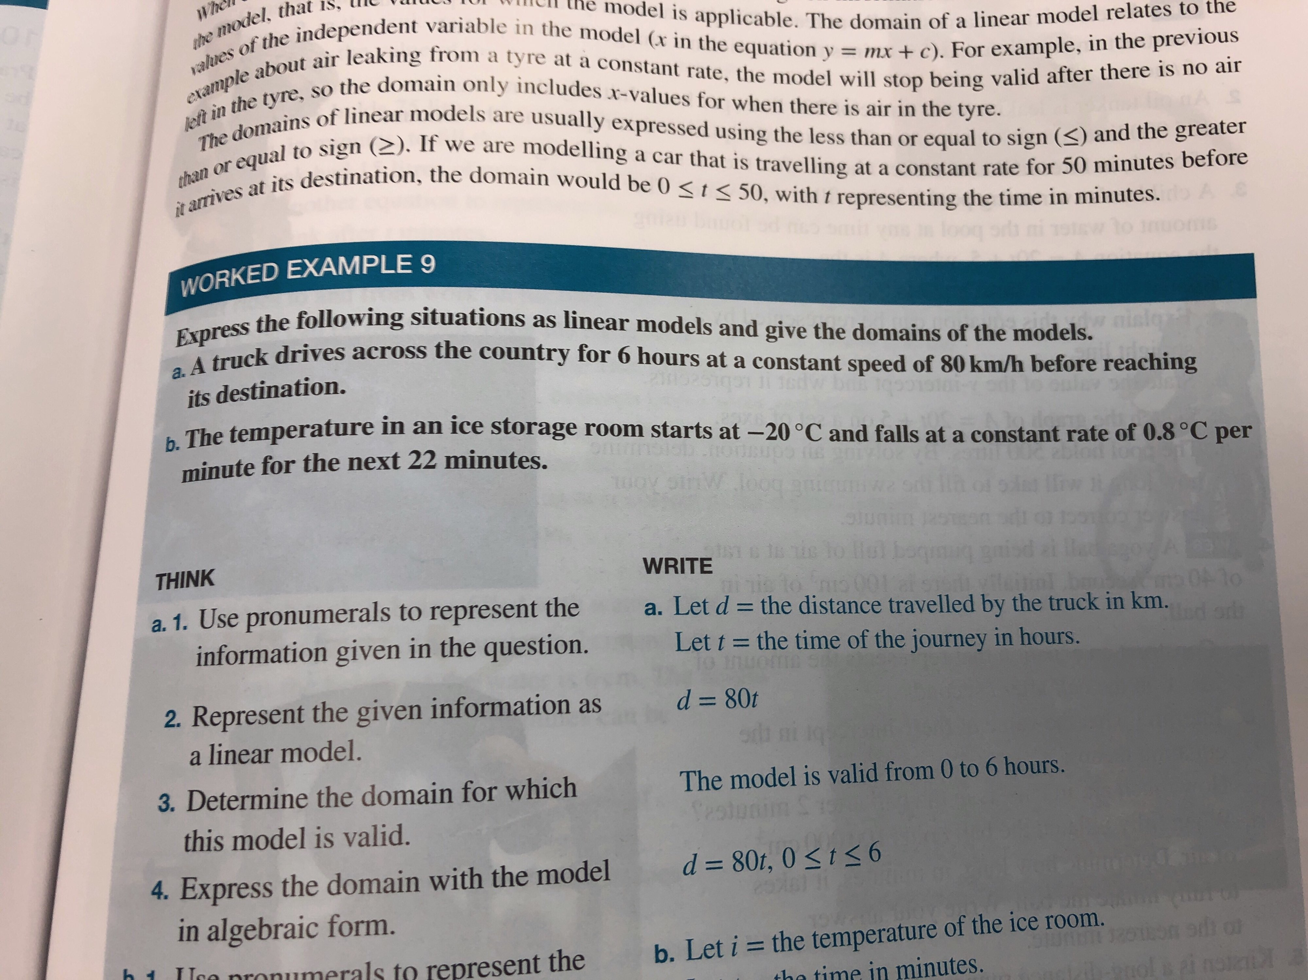

Slide 7
